Slide 1
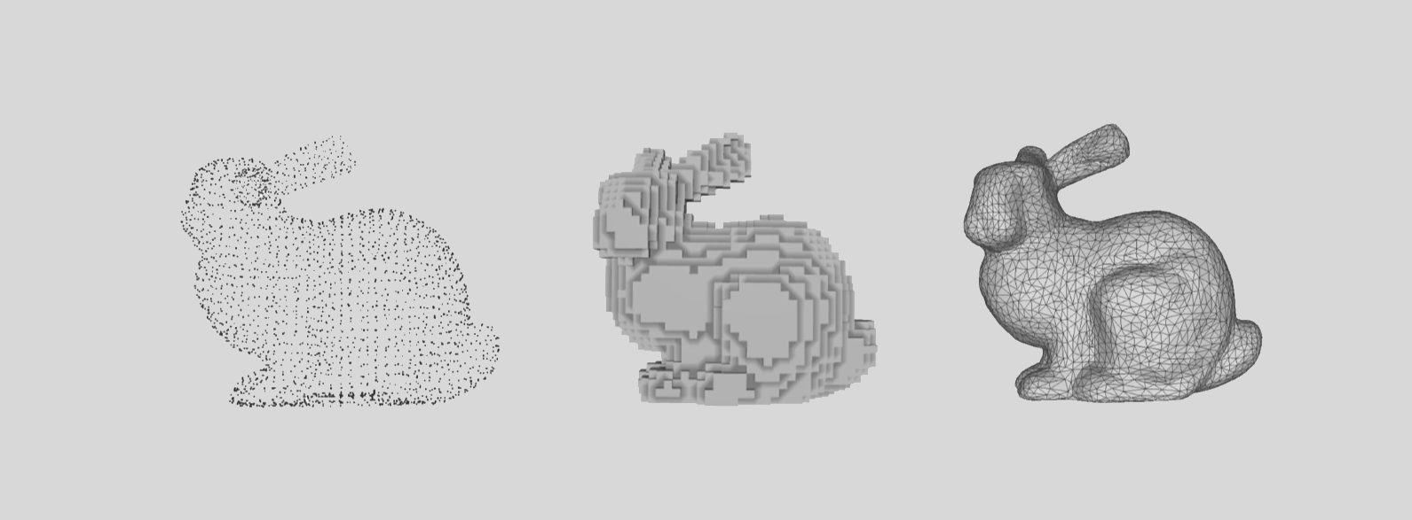

Slide 2
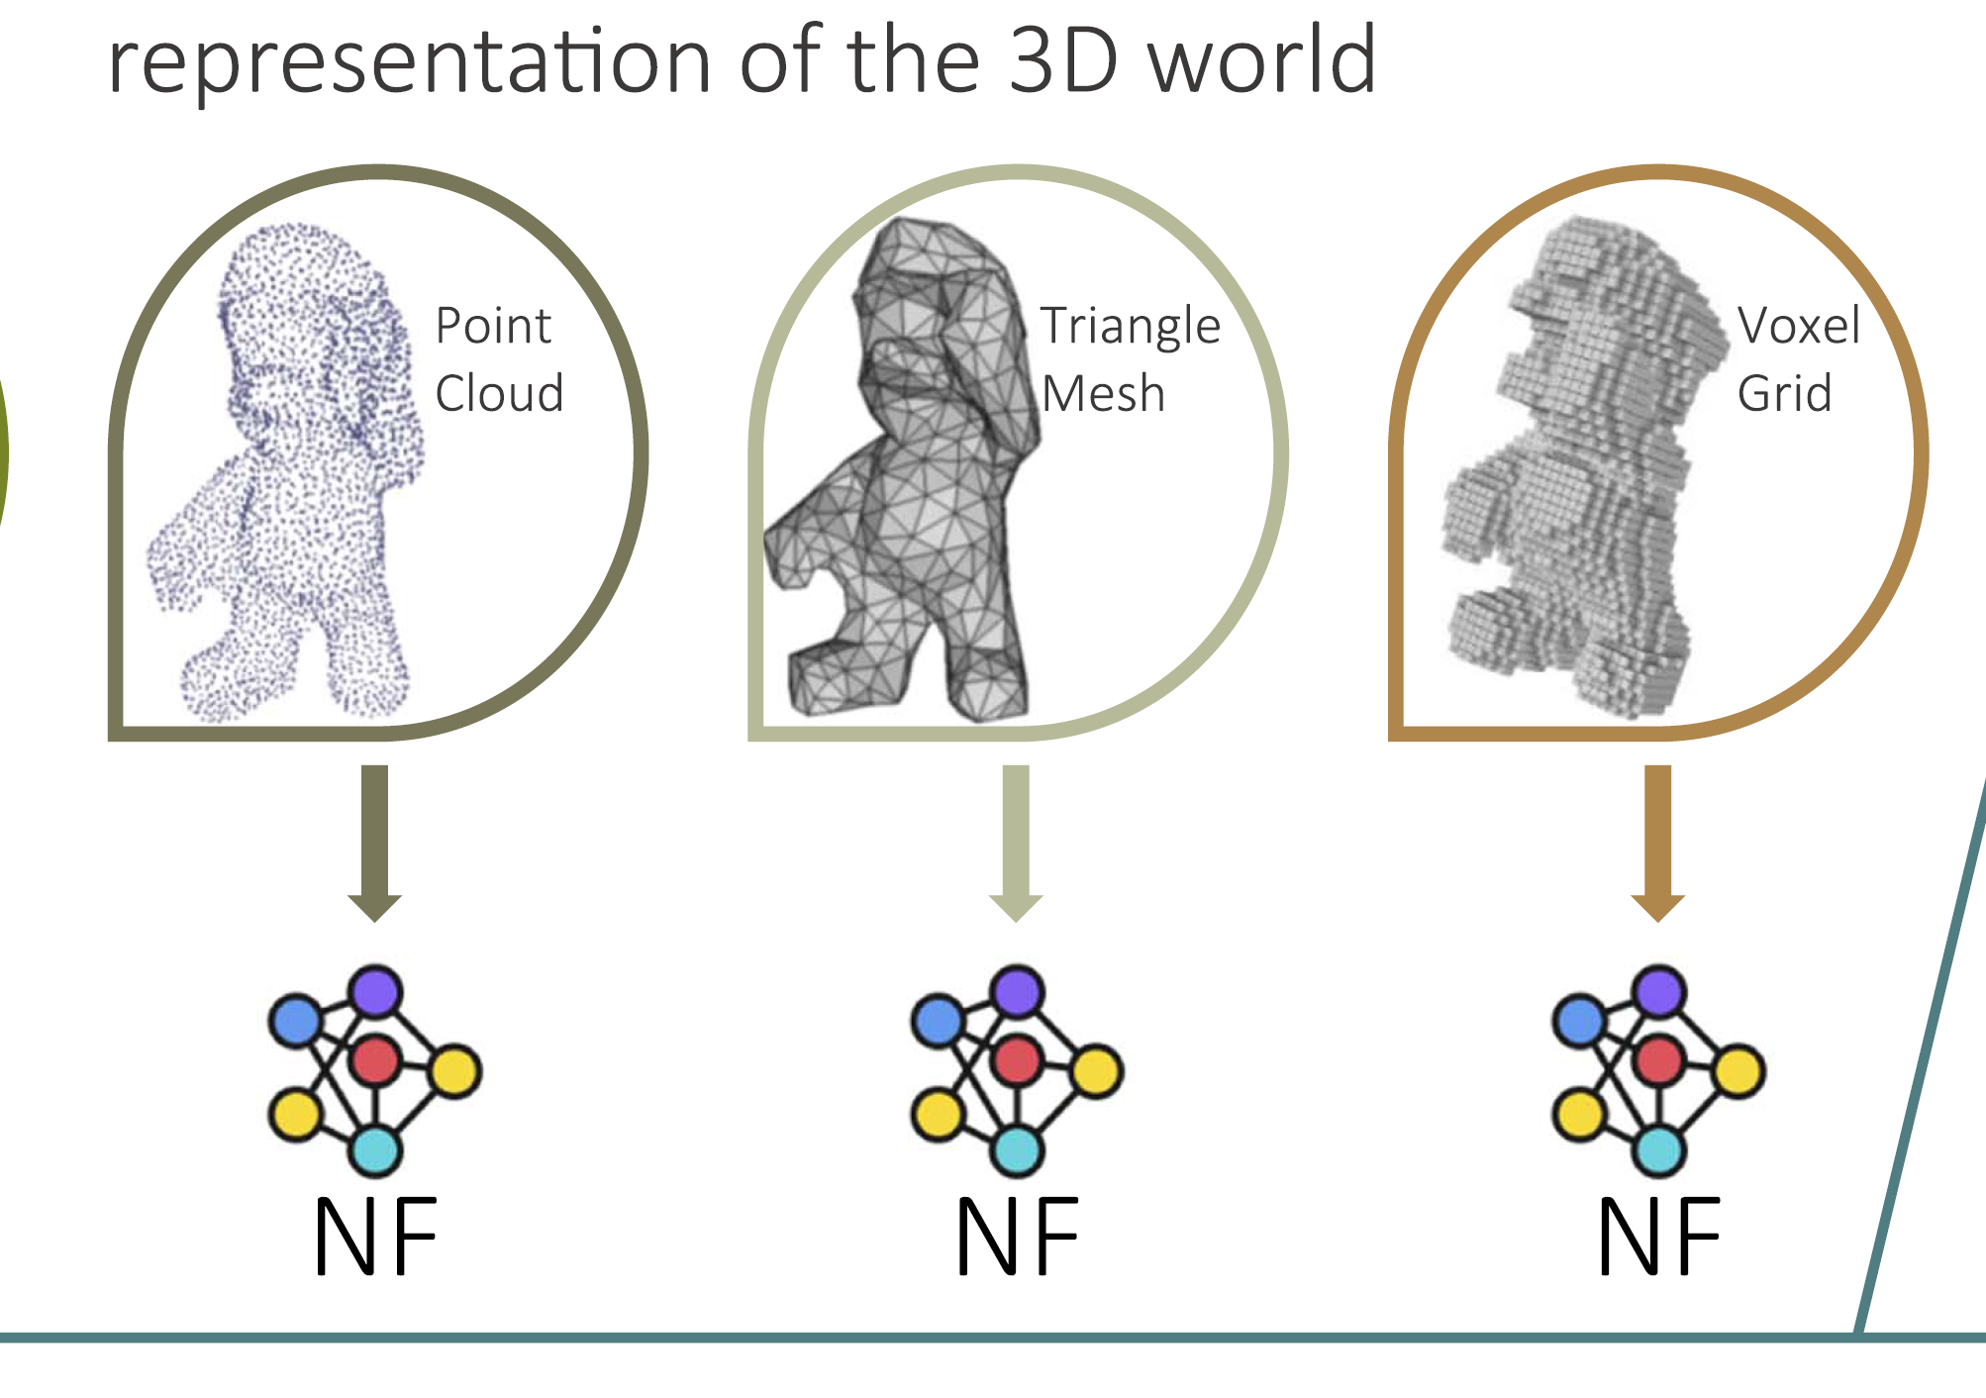
The 3D Representation Problem
Why We Need Better 3D Representation
Computer Vision has always struggled with fragmented 3D data representations including voxel grids, point clouds, and meshes.
Each representation requires specialized algorithms and architectures, preventing a unified approach to 3D processing.
Current discrete representations suffer from resolution limitations and memory constraints.
There is no standard way to store process 3D data across different applications.

Slide 3
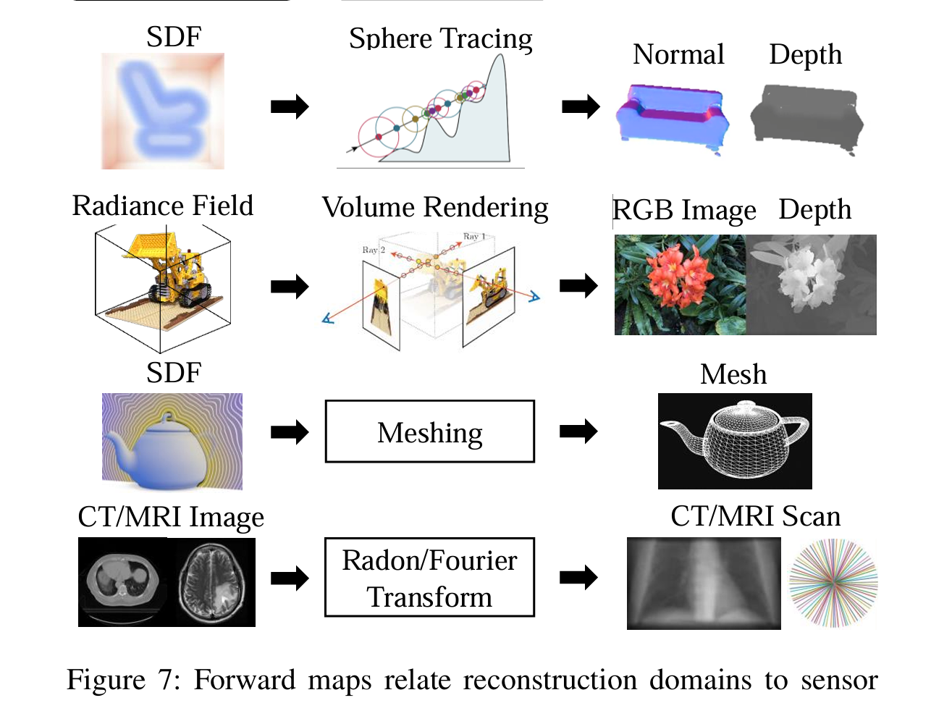
Enter Neural Fields
Neural Fields as Continuous 3D Representations
Neural Fields (NFs) are continuous functions defined at all spatial coordinates, parameterized by neural networks.
They represent 3D surfaces using functions like Signed Distance Fields (SDF), Unsigned Distance Fields (UDF), and Occupancy Fields (OF).
Neural Radiance Fields (NeRFs) capture both geometry and appearance by outputting RGB colors and density values.
The memory cost is decoupled from spatial resolution, allowing arbitrarily fine reconstruction from fixed parameters

Slide 4
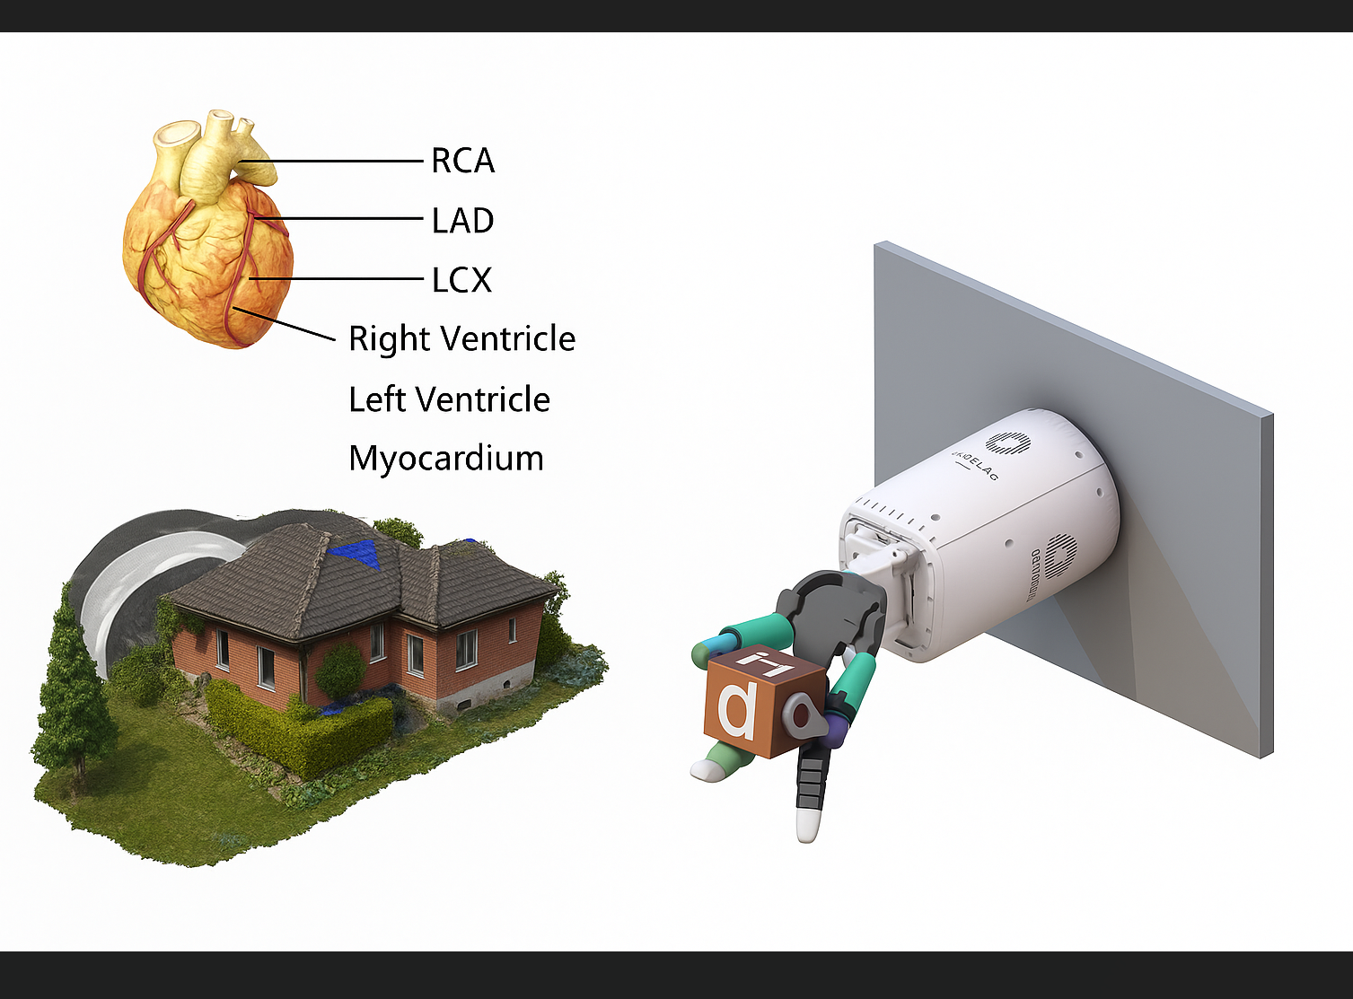
Practical Applications and Use Cases
Real-World Deployment Scenarios
3D Content Creation: Generate and edit 3D models through latent space manipulation for gaming and VR applications.
Robotics: Enable fast 3D shape understanding for object manipulation and scene understanding tasks.
Medical Imaging: Process 3D medical scans represented as neural feilds for diagnosis and treatment planning.
Digital Twins: Efficiently store and process large collections of 3D objects in industrial applications

Slide 5
Key Terminology and Research Question
Understanding Object-Centric Neural Processing
Neural Implicit Representations: Functions parameterized by neural networks that implicitly define 3D geometry or appearance.
Object-Centric: Focus on individual objects rather than entire scenes, enabling better generalization and transfer.
Research Question: Can we directly process neural field weights using deep learning pipelines for downstream tasks?
This challenges the traditional approach of sampling the underlying function and instead process the network parameters themselves.

Slide 6
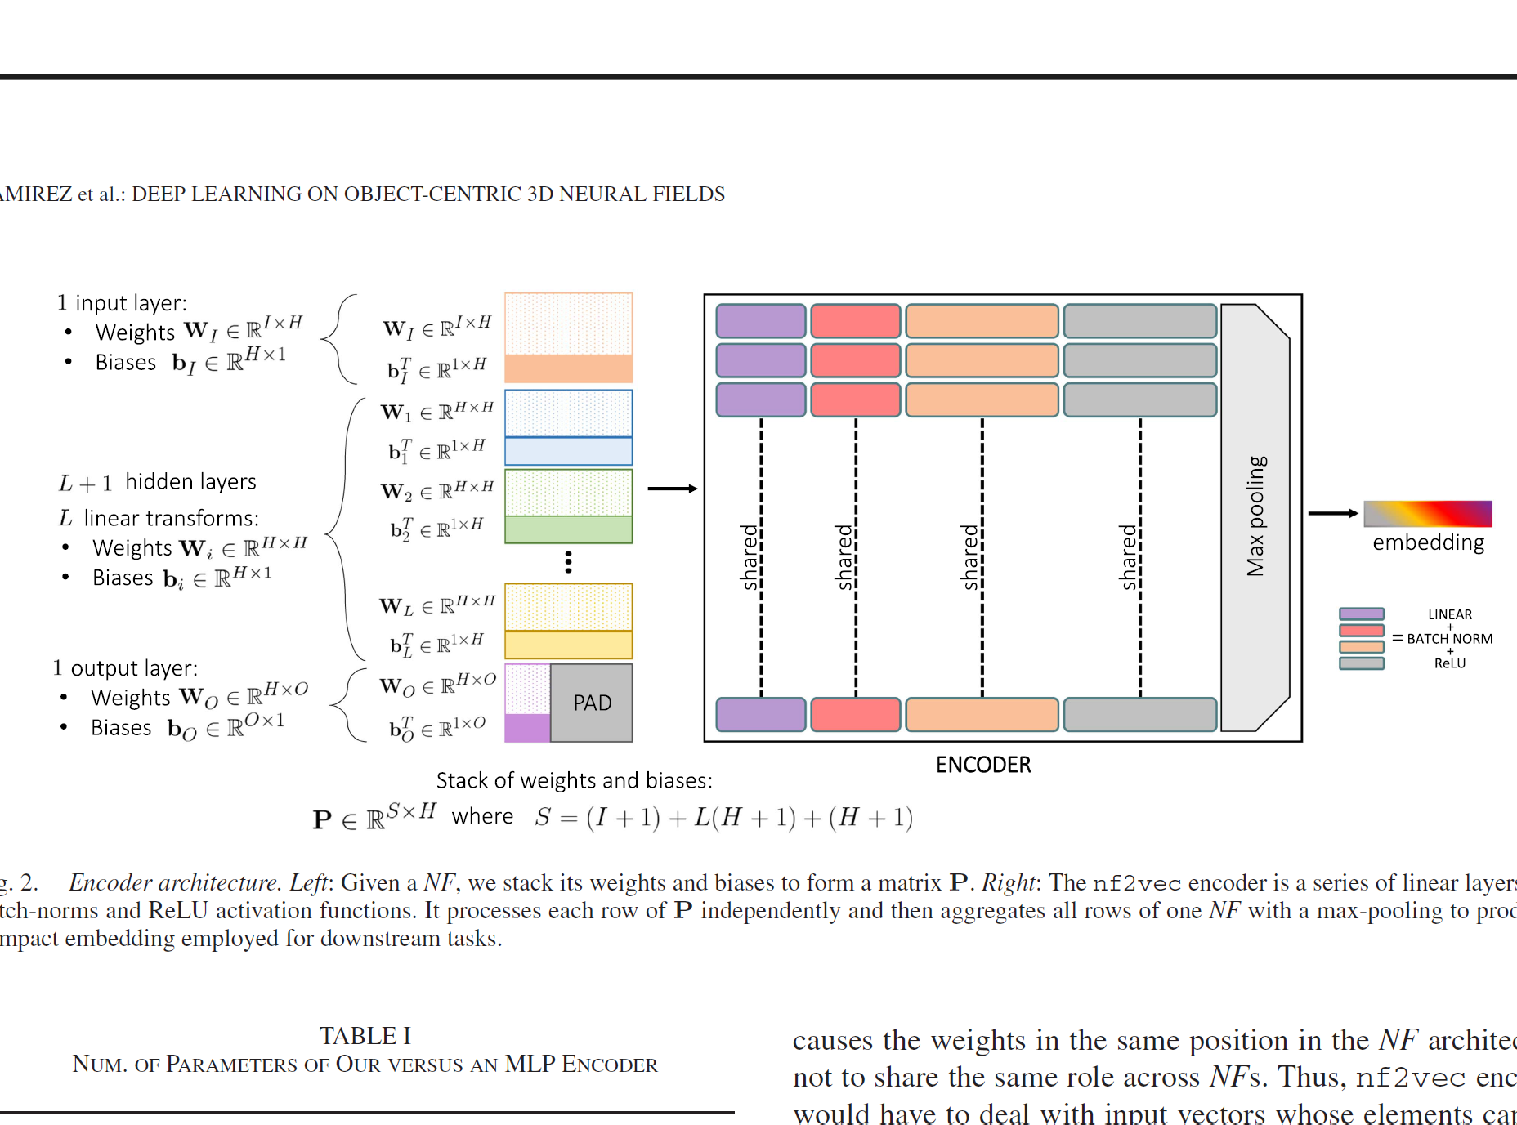
The nf2vec Famework Overview
Architecture for Neural Field Processing
Nf2vec generates compact latent representations for input neural fields thourgh a single inference pass.
The framework consists of an encoder that processes NF weights and an implicit decoder for reconstruction
The encoder sues a series of linear layers with batch normalization, processing each row of stacked weights independently
Max pooling aggregates all weight rows into a single compact embedding vector

Slide 7
Weight Matrix Representation
Structuring Neural Field Weights For Processing
Neural field weights are stacked into a matrix P with dimensions S × H, where S represents total parameters and H is hidden layer width.
Input, hidden, and output layer weights are concatenated with bias terms to form unified representation.
Output layers are zero-padded when they have different dimensions to maintain consistent matrix structure.
Shared initialization across all neural fields is crucial for weights alighment and traning covergence.

Slide 8
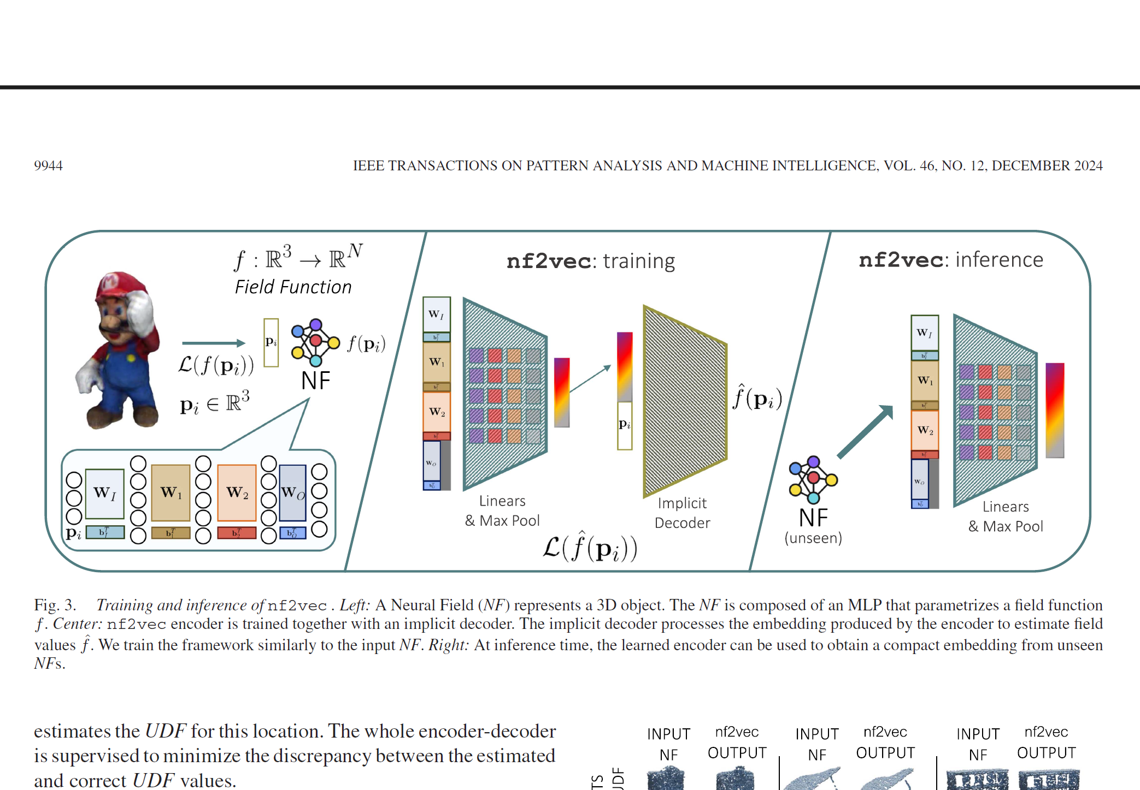
Traning Strategy and Loss Functions
Learning Meaningful Neural Field Representations
The decoder predicts original field values rather than reconstructing input weights, focusing on function representation over parameter recovery.
Traning mimics the original neural field optimization: UDF/SDF training uses ground truth distance values from discrete representations.
NeRF traning employs volumentric rendering with L1 loss between predicted and true RGB pixel intensities
Background pixels receive lower weighting (0.2) compared to foreground pixels (0.8) to focus on object structure

Slide 9
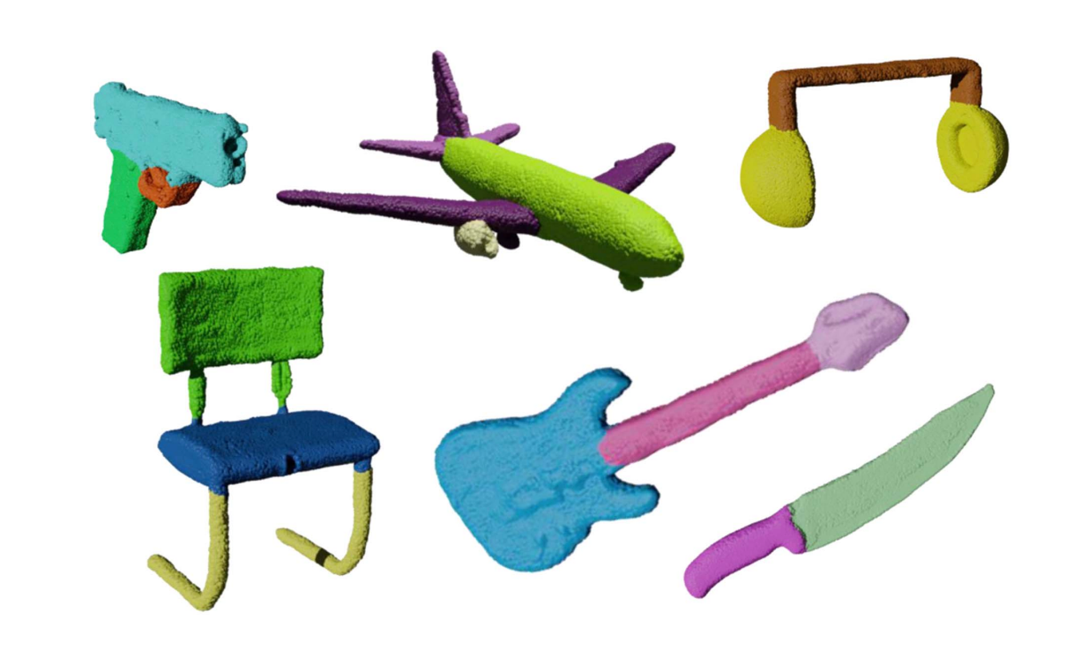
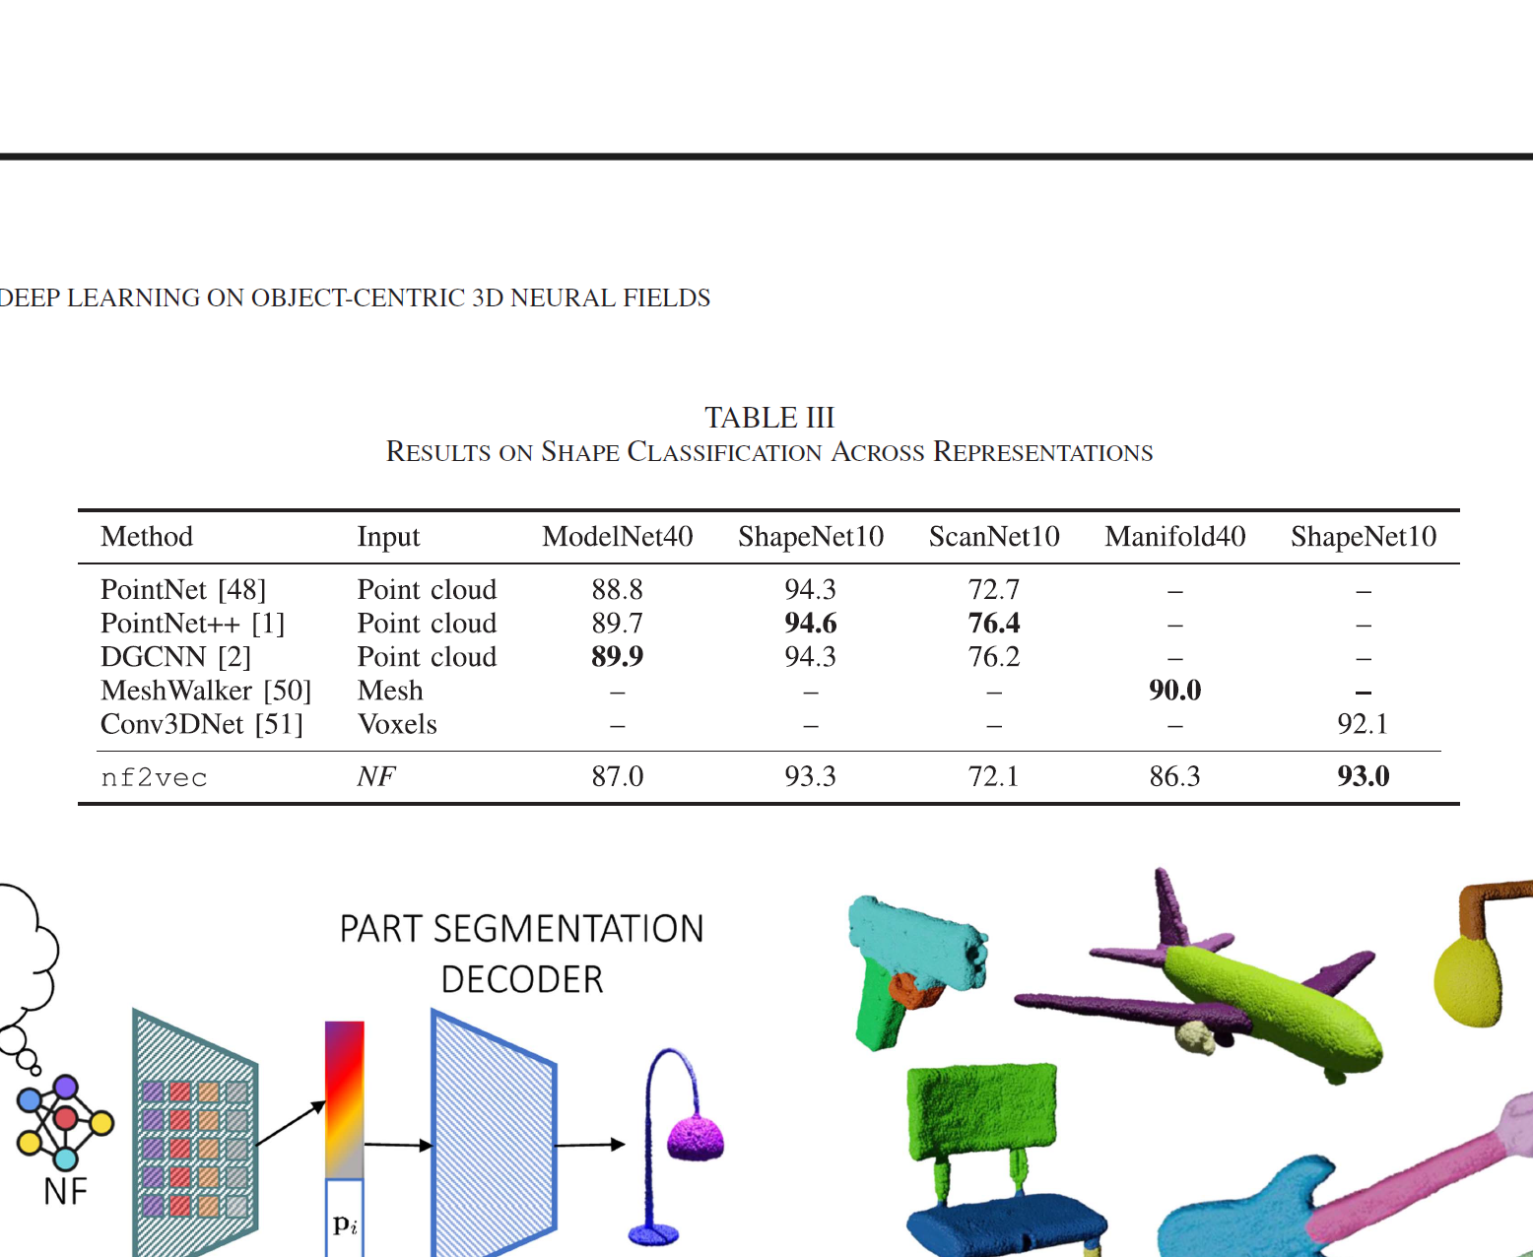
Experimental Validation – Classification Results
Performance on 3D Shape Understanding Tasks
nf2vec achieves competitive classification accuracy across ModelNet40 (87.0%), Manifold40(86.3%), and ShapeNet10 (93.0%) datasets.
The framework enables unified processing of different 3D representations (point clouds, meshes, voxels) using identical downstream architectures.
Inference time remains constant regardless of underlying signal resolution, offering significant computational advantages.
Results demonstrate that neural field embeddings retain essential geometric information for discrimitative tasks.

Slide 10
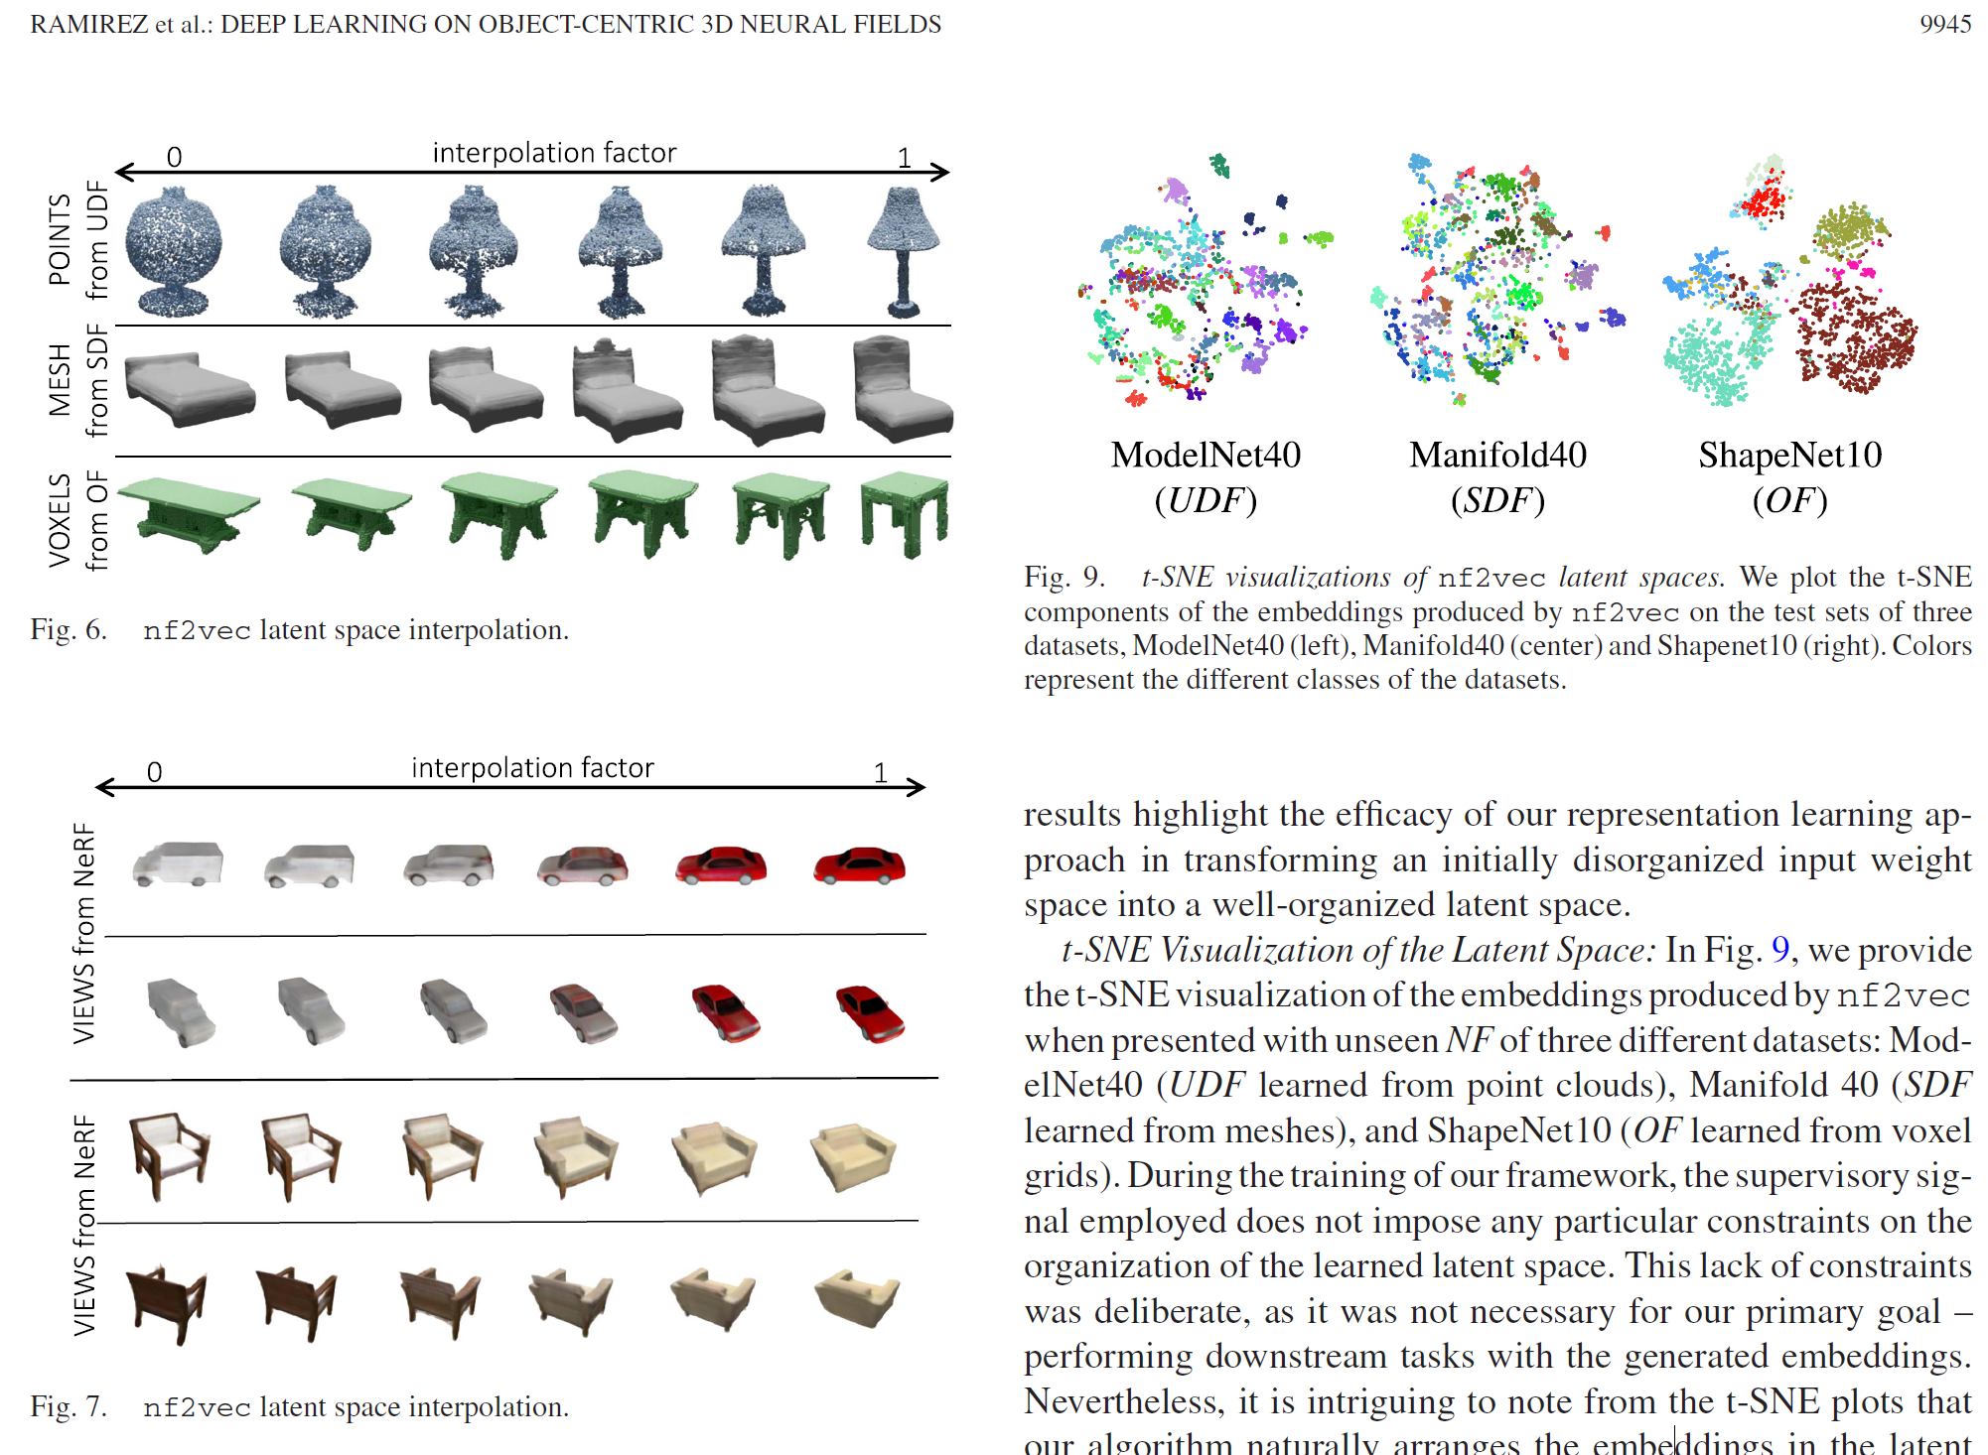
Qualitative Results and Latent Space Properties
Smooth Interpolation and Semantic Organization
Linear interpolation in nf2vec latent space produces smooth transitions between different 3D shapes.
t-SNE visualizations reveal semantic clustering where objects of the same category naturally group together.
Reconstruction quality from compact embeddings closely matches original neural field outputs.
The learned latent space enables novel shape generation through simple linear operations.

Slide 11
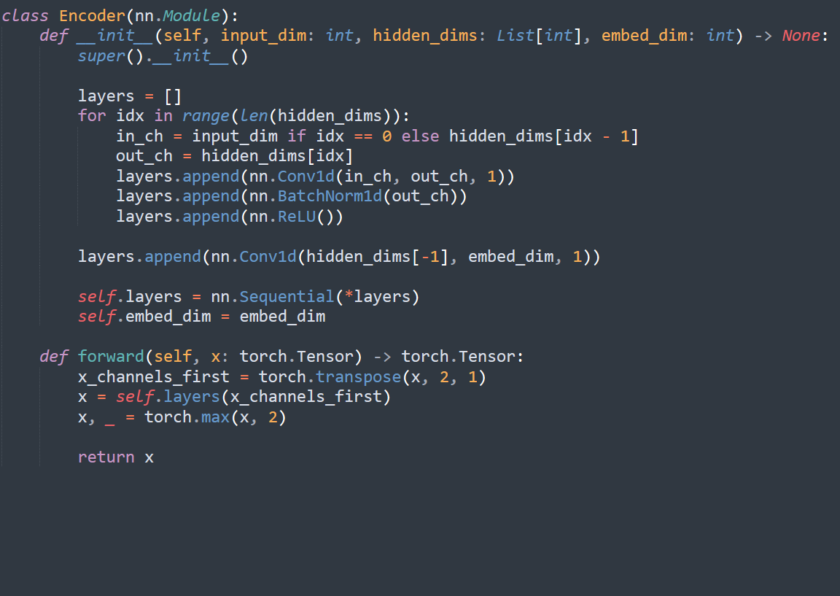
Implementation Archtirecture Details
Building nf2vec from Scratch
Same encoder for all neural field types (processes weights the same way)
Same embedding space (1024-dim) for all types, enabling cross-modal applications
Different decoder heads depending on what the original nerual field represented: Surface fields -> scalar output NeRFs -> RGB + density output

Slide 12
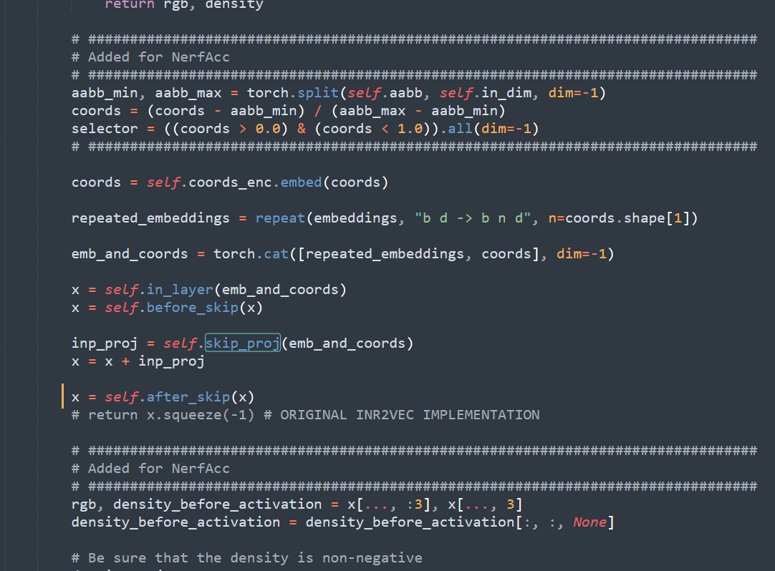
Decoder Architecture Implementation
Code Deep-Dive: From Embeddings to 3D Representations
Coordinate Encoding: Uses tinycudann for high-frquency positional encoding of 3D coordinates before processing.
Skip Connections: Embeddings + coordinates are injected both at input and after several hidden layers for better gradient flow.
Conditional Output: Surface fields output single scalar values, while NeRFs output 4-channel (RGB + density) with specialized activations.
Spatial Bounds: NeRF decoder includes AABB(axis-aligned bounding box) normalization.

Slide 13
Critical Implementation Considerations
Ensuring Successful Traning
Shared weight initialization across all neural fields is absolutely essential for convergence and meaningful embeddings.
Data augmentation is applied offline to neural field datasets rather than online during traning.
Input and output layers of SIREN networks are discarded during processing as the ydont contribute to downstream tasks.
Linear mode connectivity between neural fields with identical initialization enables meaningful weight interpolation.

Slide 14
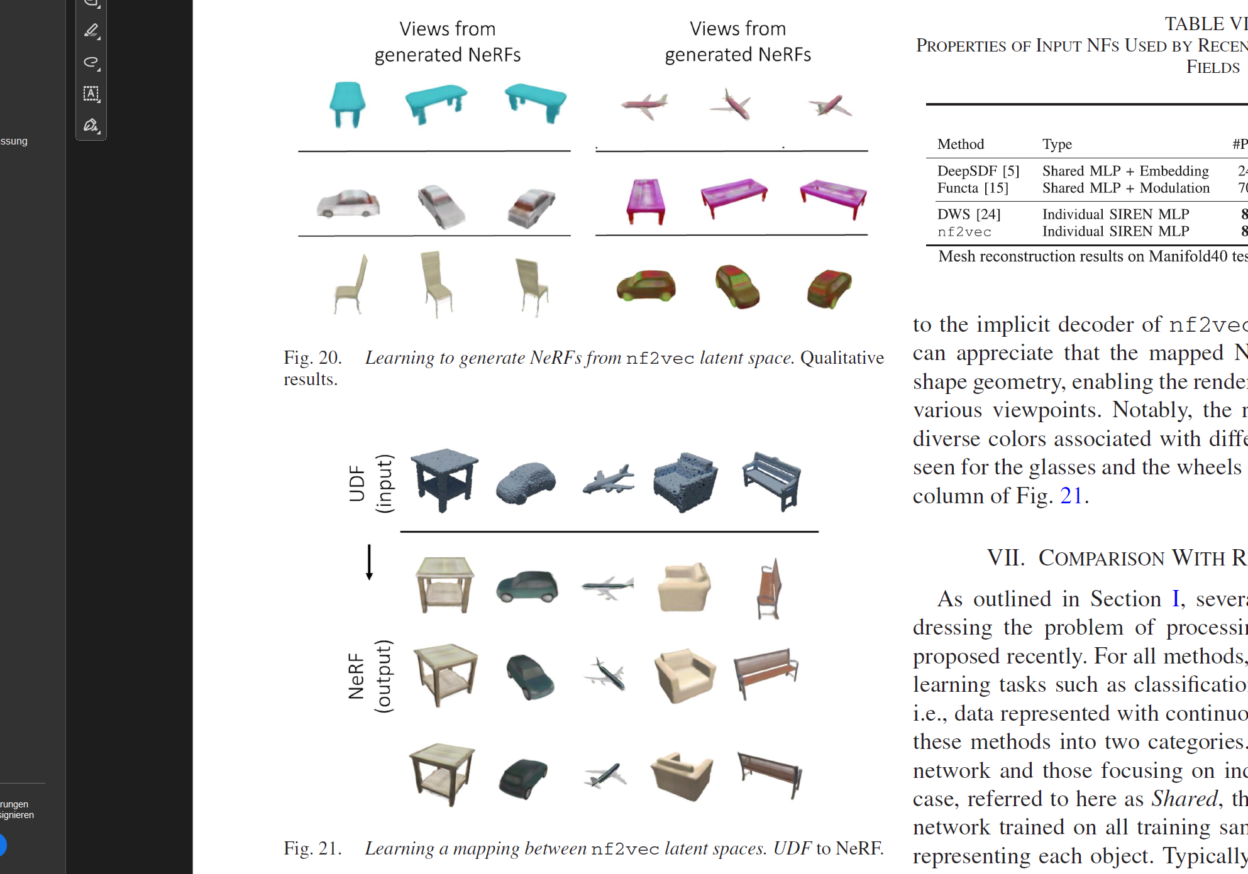
Extension to Neural Radiance Fields
Processing Geometry and Appearance Together
nf2vec successfully extends to NeRFs that capture both 3D structure and visual appearance.
NeRF classification achieves 87,28% accuracy while being two orders of magnitude faster than image-based baselines.
The framework enables direct NeRF-to-NeRF generation and cross-modal mapping from geometry to appearance.
Volumetric rendering during traning ensures that embeddings capture view-consistent 3D information.

Slide 15
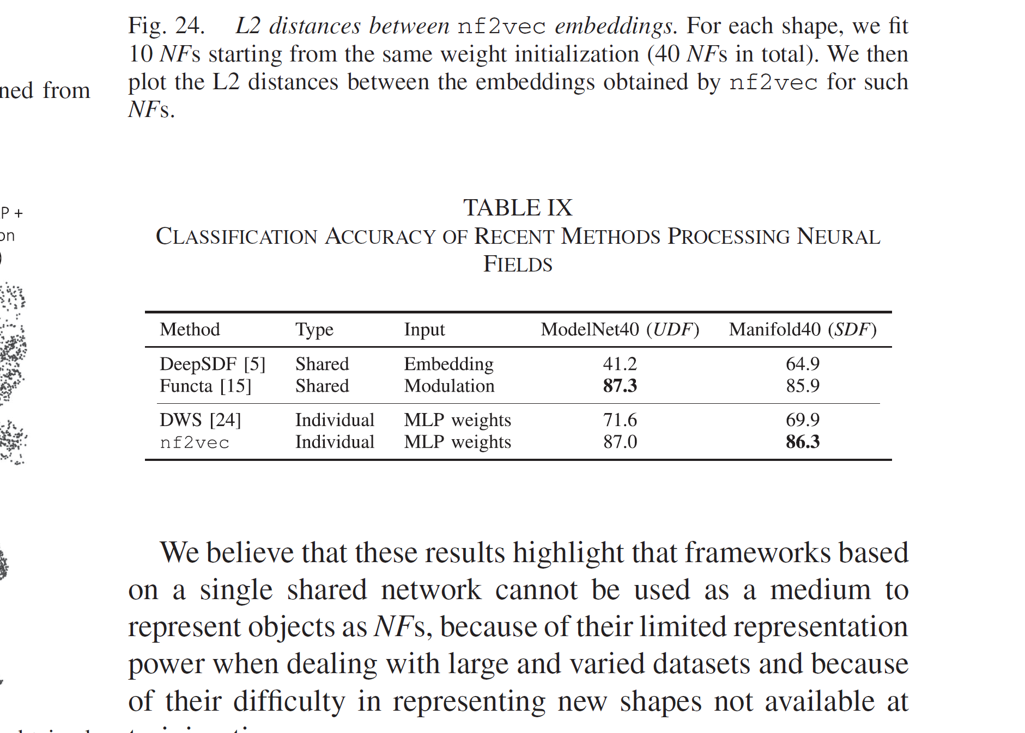
Comparison with Recent Methods
Benchmarking Against State-of-the-Art
nf2vec outperforms recent neural field processing methods including DWSNet, NFN, and NFT on classification tasks.
Individual nerual field approaches significantly outperform shared network methods (Functa, DeepSDF) in reconstruction quality.
The Framework achieves the best balance between classification accuracy and representation fidelity.
First comprehensive benchmark for neural field classification establishes baseline for future research.

Slide 16
Limitation and Challenges
Current Constraints and Known Issues
Classification accuracy occasionally falls short of specialized architectures designed for specific 3D representations.
No straightforwards method exists for online data augmentation directly on neural field weights.
NeRF processing entangles geometry appearance, limiting control over individual aspects.
Shared initialization requirement constraints the flexibility of neural field architectures.

Slide 17
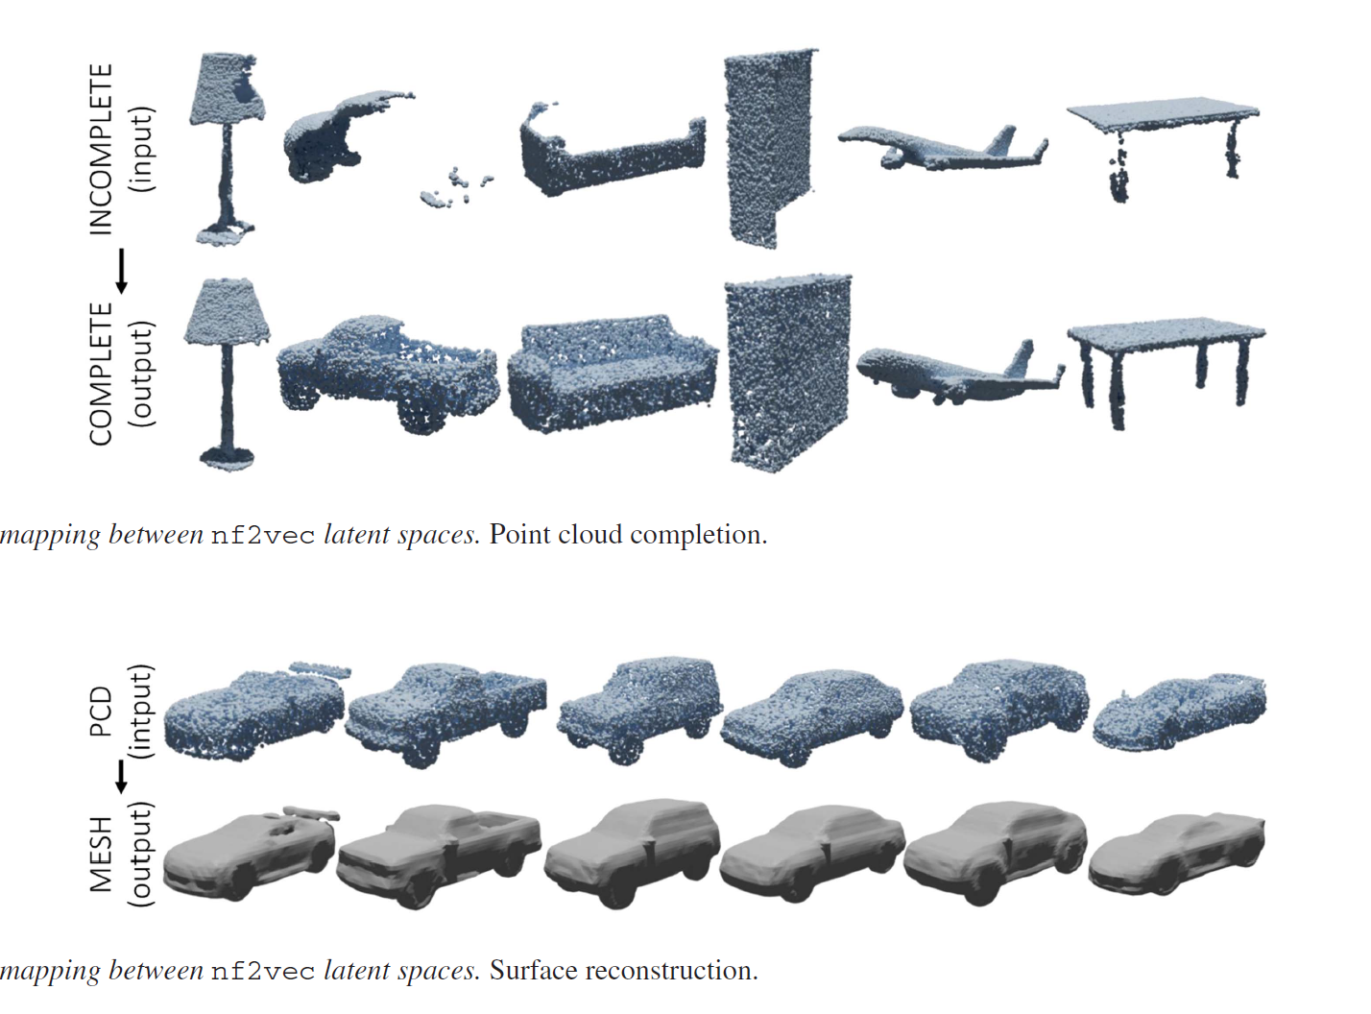
Advanced Applications – Shape Completion and Generation
Learning Mappings Between Neural Field Spaces
Transfer functions can map between different neural field representations using simple MLPs trained with MSE loss.
Point cloud completion achieved by learning mappings from incomplete to complete shape embeddings.
Surface reconstruction enables conversion from point clouds to mesh representations through latent space operations.
Latent-GAN traning on nf2vec embeddings enables unconditional shape generation at arbitrary resolutions

Slide 18
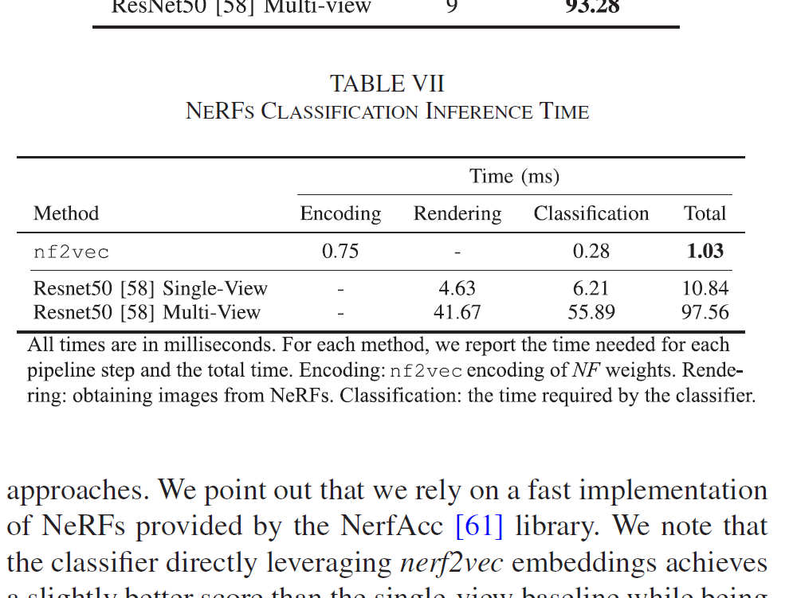
Performance Analysis and Scalability
Computational Efficiency and Scalability
nf2vec processes neural fields in constant time regardless of the underlying signal resolution.
Classification inference takes only 1.03ms compared to 97.56ms for multi-view ResNet baselines.
Memory usage scales gracefully with input neural field size due to row-wise processing architecture.
The framework support batch processing of multiple neural fields for imporved throughput.

Slide 19
Future Research Directions
Extending Beyond Current Capabilities
Multi-Scale Processing: Develop hierarchical neural field representations for handling objects at different scales simultaneously.
Disentangled Representations: Separate geometry and appearance in NeRF processing for independent control and manipulation.
Online Augmentation: Create methods for augmenting neural field weights directly without requiring discrete representation conversion.
Scene-Level Processing: Extend from object-centric to full scene understanding with multiple objects and complex interactions.

Slide 20
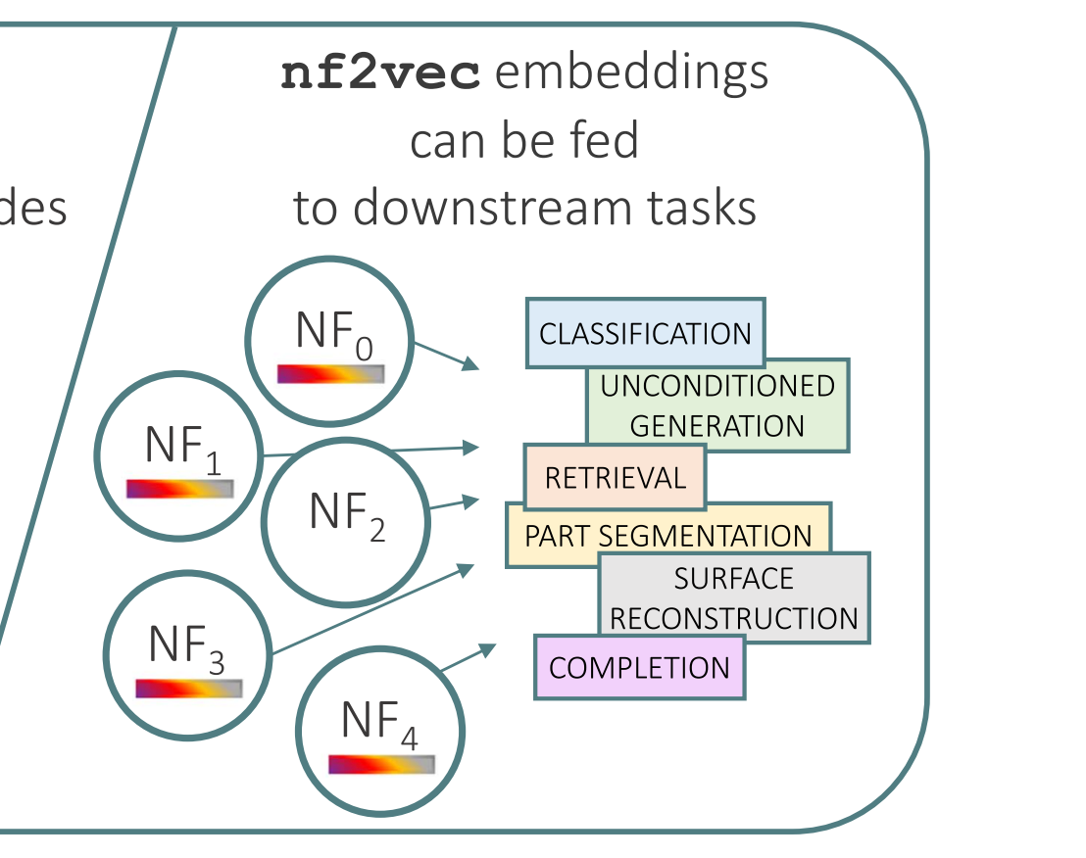
Conclusion and Impact
Transforming 3D Deep Learning
nf2vec demonstrates that direct neural field weight processing is both feasible and effective for 3D understanding tasks.
The framework provides a unified approach to processing diverse 3D representations without specialized architectures.
Competitive performance with significant computational advantages makes the method practical for real-world deployment.
This work opens the path torward neural fields becoming a standard 3D representation in computer vision and computer graphics.

Slide 21
Where could we be in 10 years?
Describing a chair to an Architect. The neural encoding could understand words like „comfort“ or „aesthetics“ in 3D Space, moring objects in real-time.
LLM‘s could use 3D space for communicating. Right now their mostly limited to words and 2D images.

Slide 22
The 3D Representation Problem
Why we
Page 1, 2, 6, 7, 8, 9, 10, 12, 13, 17, 18 Figure: Deep Learning on Object-Centric 3D Neural Fields
Page 3 Figure: Neural Fields in Visual Computing and Beyond
Page 4 Figure: Medical Image Processing, Robotics, Automatic Image Analysis

Slide 23
The 3D Representation Problem
Why we

